Slide 1
Meeting – 13th Aug 2013
Viktor Maier
viktor.maier@cern.ch

Slide 2
Table of content
Beta-Beat-GUI
GetLLM
OMC wiki
Open Issues
Tests and TDD
OMC code on Windows
Python_Classes4MAD as submodule
Cleaning Beta-Beat.src

Slide 3
Beta-Beat-GUI
Switched to JDK7
Proposed changes:
Implementing of Simons postprocessing script (GitHub Issue #33)
LSA Software to save TFS data to a database
Adapting LSA-API changes(Oct‘13)

Slide 4
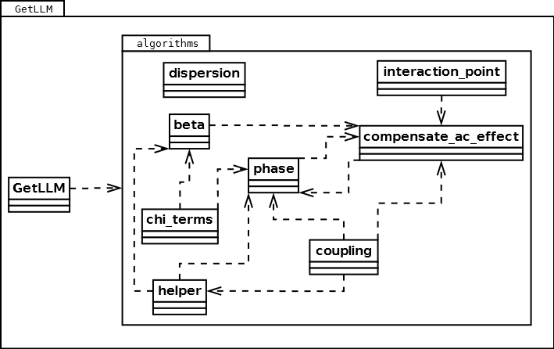
GetLLM
Splitted in several files
More robust:
Error catching
Only one plane possible
Empty tfs files
Formatted output
At least 7 BPMs →back to 3

Slide 5
OMC wiki
http://omc-wiki.web.cern.ch/OMC-wiki/
GUI user manual
Coding tutorials
Python style guide
Git tips
Glossary

Slide 6
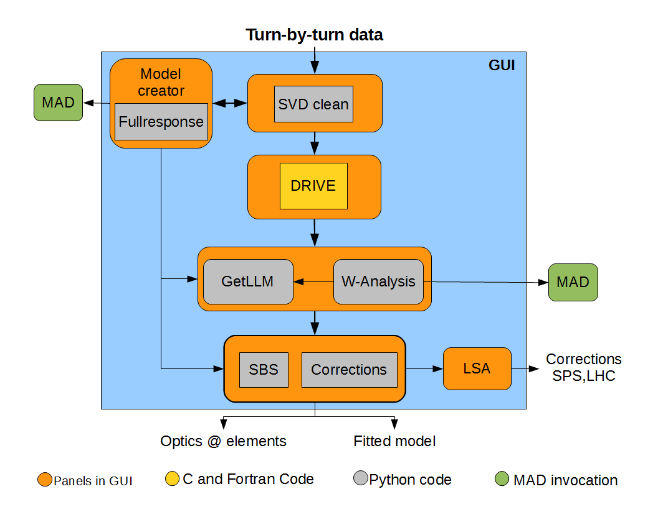
OMC wiki

Slide 7
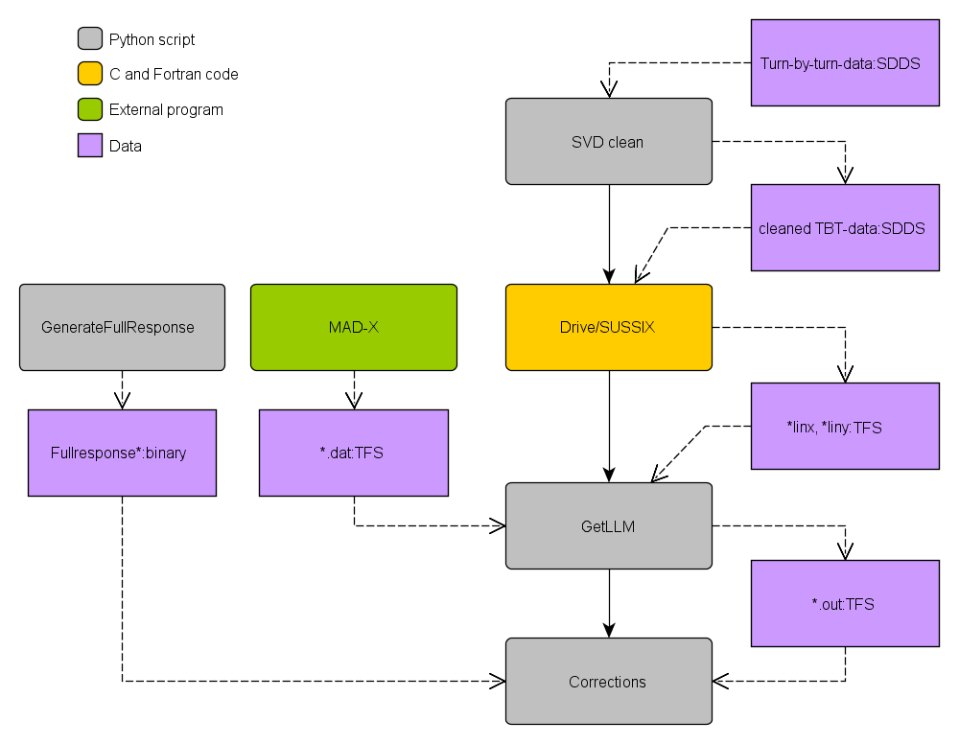
OMC wiki

Slide 8
Open Issues
#28 get_ip_2:
Traceback (most recent call last):
File “…\Beta-Beat.src\GetLLM\algorithms\interaction_point.py", line 290, in _get_ip_2
rt2j = math.sqrt(amp_l*amp_r*sin(dpsi)/(2*L))
ValueError: math domain error
x = dpsi mod 2PI ; 0<=x<=PI
plane = V
beam_direction = 1
lhc_phase = 0
dpsi = 2*np.pi*(tune+beam_direction*(t_f.MUY[t_f.indx[bpmr]]-t_f.MUY[t_f.indx[bpml]]))

Slide 9
Open Issues
#14 Obsolete files in Beta-Beat.src/CoreFiles!?
CorrectionsValues.txt:
SPS1
0
BETA-BEATING
1
0
0
FFTTerms.txt:
29.0
0.130
0.17 0
330
0.017
0.04
0.1
0.4
0.45
330

Slide 10
Open Issues
#11 Validate coupling f1001 in GetLLM
coupling f1001 in GetLLM.GetCoupling(1|2) has to be checked with simulations.
#10 Check correctness of GetLLM.Getsextupole()
There are doubts about the correctness of GetLLM.Getsextupole() and therefore it should be tested.

Slide 11
Open Issues
#9 Check necessity of Drive.inp in getcoupling(1|2)
From Ryoichi:
One more comment. fracx and fracy are used to define sign_QxmQy and this sign_QxmQy is used to calculate the global coupling in the end.
I didn't do much about the global coupling and don't remember well. But all we need must be sin(pi(Qx-Qy)) and sin(pi(Qx+Qy)) so I wonder why we need sing_QxmQy.
In other ways, there may be a way to do the calculation of the global coupling just from abs(Qx-Qy).
if fracx >fracy:
sign_QxmQy = 1.0
else:
sign_QxmQy = - 1.0
...
QG= (QG/len(dbpms) +
0.5*(1.0 - sign_QxmQy*0.5))%1.0

Slide 12
Tests
getsuper
GetLLM
Drive
Further small tests
Verifiy that the scripts still produce same output after changes but not correction!

Slide 13
Test-driven development(TDD)
Development approach
First tests, then production code
Done, if tests passes
Tests are easier to write
Tests available for further refactoring
Maybe for Piotr‘s algorithm?

Slide 14
OMC code on Windows
GetLLM
Drive
GUI
Mad-X for win available
Mad-X scripts depends on symbolic links!
Better: Put all necessary symbolic links into Beta-Beat.src (but no solution)

Slide 15
Python_Classes4MAD as Git submodule
Why is it not on GitHub?
It would be a perfect Git submodule of Beta-Beat.src

Slide 16
Cleaning Beta-Beat.src
Big directory: ~1400mb
*.py scripts: ~10mb
A lof of untracked files: ~400mb
Move tests and testdata to Beta-Beat.test?

