Slide 1
Normal and skew sextupole polarity checks

Slide 2
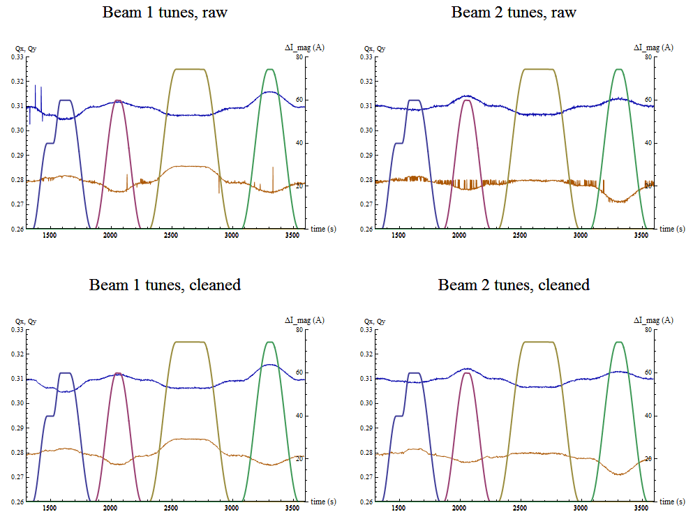
Measured tunes and magnet currents (from Timber)
Qx
Qy
SSX3.L1
SSX3.R1
SX3.R5
SX3.L5

Slide 3
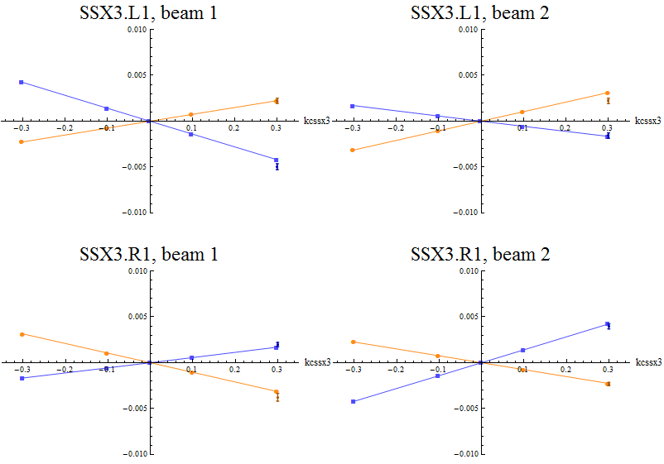
Measured tune shift and MADX predictions
δQx, model
δQx, meas
δQy, model
δQy, meas
Polarities are correct

Slide 4
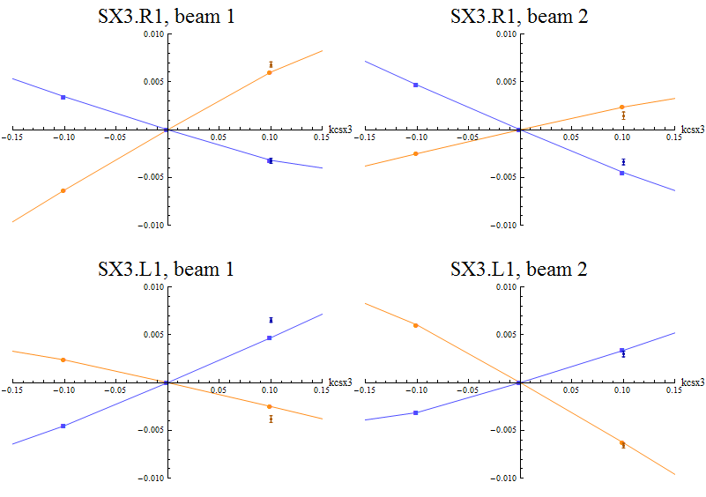
Measured tune shift and MADX predictions
δQx, model
δQx, meas
δQy, model
δQy, meas
Polarities are correct

