Slide 1
Studies for TBT optics measurements in the PSB
M. McAteer
15/08/13

Slide 2
Measured PSB trajectories (transverse damper off)
Qx
Noise peaks

Slide 3
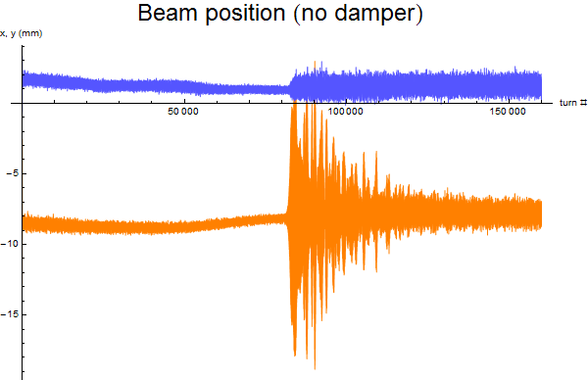
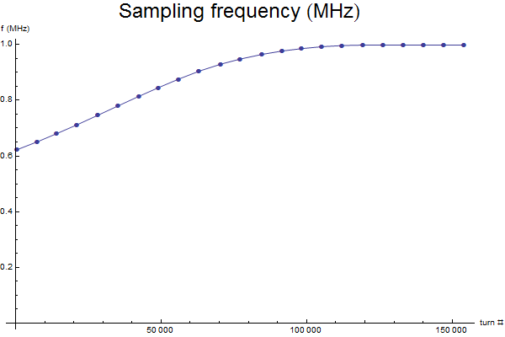
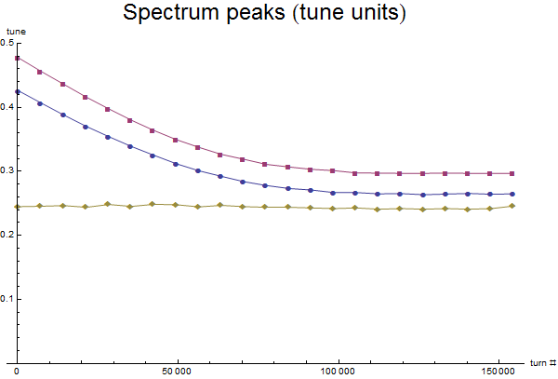
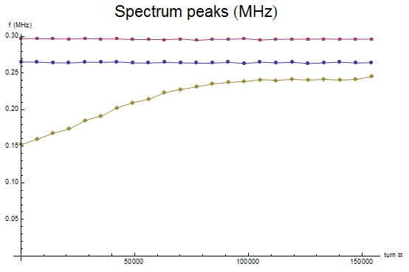
Measured PSB trajectories-“noise” peaks
Noise peaks
Qx
Noise peaks
Qx
With transverse damper disabled, beam becomes unstable when noise
Peaks approach the tune (at ~390 ms at normal operational tune).
Normalizing to revolution/sampling frequency shows that the frequencies of these two peaks are constant through the acceleration cycle (0.264 and 0.297 MHz).

Slide 4
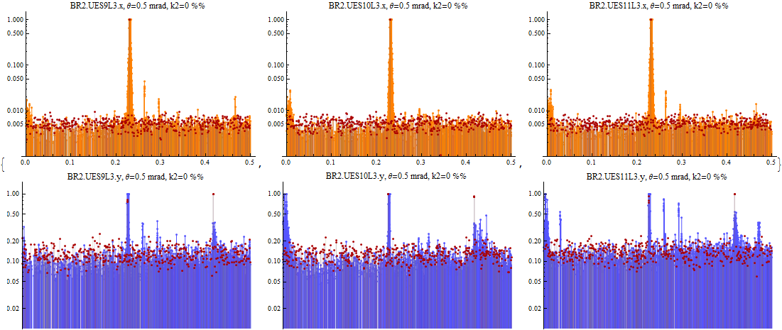
Measured and simulated spectra
Orange = measured horizontal, blue = measured vertical
(excitation with tune kicker in both planes , x amp~5 mm, y amp ~ 1 mm peak to peak, x chromaticity corrected) Red = simulated (tracking simulations with no random errors added to bending magnets, x amp~5 mm, y amp ~ 1 mm peak to peak)

Slide 5
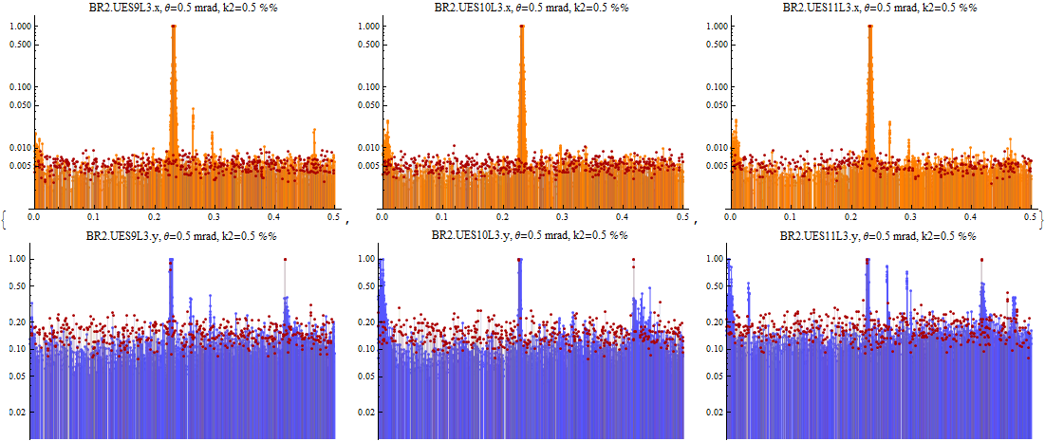
Measured and simulated spectra
Orange = measured horizontal, blue = measured vertical
(excitation with tune kicker in both planes , x amp~5 mm, y amp ~ 1 mm peak to peak, x chromaticity corrected) Red = simulated (tracking simulations with K2 random errors (0.5 ‰ at 0.1 m) added to bending magnets, x amp~5 mm, y amp ~ 1 mm peak to peak)

Slide 6
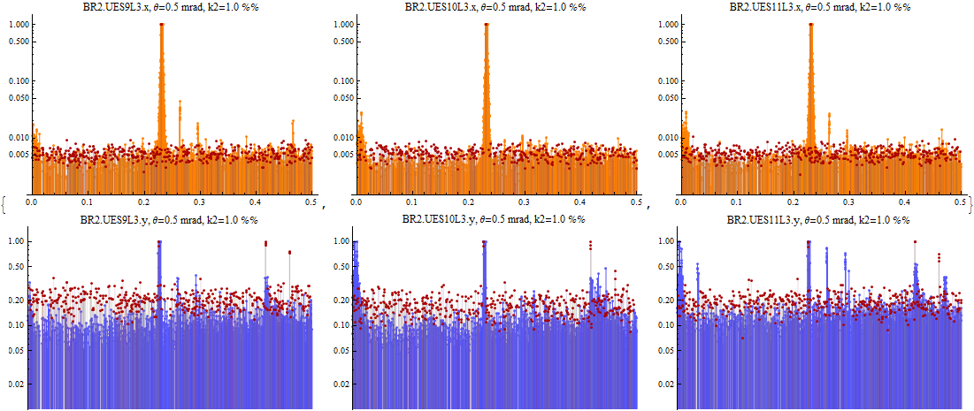
Measured and simulated spectra
Orange = measured horizontal, blue = measured vertical
(excitation with tune kicker in both planes , x amp~5 mm, y amp ~ 1 mm peak to peak, x chromaticity corrected) Red = simulated (tracking simulations with K2 random errors (1.0 ‰ at 0.1 m) added to bending magnets, x amp~5 mm, y amp ~ 1 mm peak to peak)

Slide 7
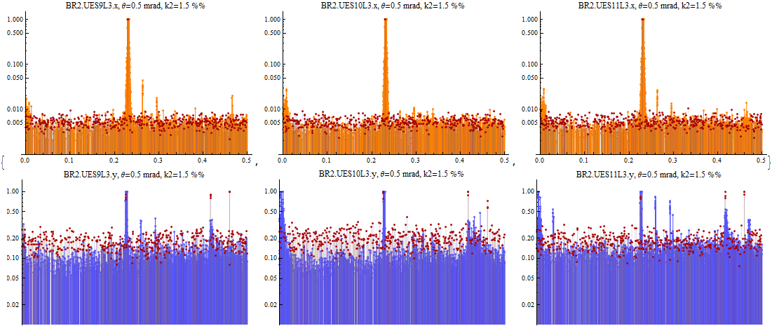
Measured and simulated spectra
Orange = measured horizontal, blue = measured vertical
(excitation with tune kicker in both planes , x amp~5 mm, y amp ~ 1 mm peak to peak, x chromaticity corrected) Red = simulated (tracking simulations with K2 random errors (1.5 ‰ at 0.1 m) added to bending magnets, x amp~5 mm, y amp ~ 1 mm peak to peak)

