Slide 1
Drive and the Action Calculation
Alex Sherman
Supervisors: Rogelio Tomas Garcia, Viktor Maier, Ewen Maclean, Phil Rubin

Slide 2
Drive: Windows Compatibility
After changes to makefile and code, Drive can now be run on windows
Commands: make clean, make - > executable output file called ‘Drive_God_lin_win.exe’
Works the same, adds a mystery space in each line of output files (unclear how to remove this)

Slide 3
Drive: Minor Changes
C->C++: use of string and fstreams objects
Data organization:
two classes with input and calculated data respectively
array of structs for each BPM with name, position, tbt data, plane, and if it’s picked up
General clean up:
unused variables deleted (hvt, allbpmamp, allbpmphase)
removed printing of BPM indices

Slide 4
Action Calculation in GetLLM
At a point $s$ along the ideal orbit, amplitude of oscillation is $A_{x,y}\left(s\right)=\sqrt{2J_{x,y}β(s)}$ (*)
So $2J_{x,y}=\frac{{\left(A_{x,y}\left(s\right)\right)}^{2}}{β\left(s\right)}$
$2J_{x,y}$ was previously being calculated as:
$\sqrt{2J_{x,y}}=\frac{\sum_{BPMs}{\frac{\frac{1}{2}PK2PK_{x,y}}{\sqrt{β}}}}{\#BPMs}$ , or $\sqrt{2J_{x,y}}$=mean{$\sqrt{2J_{x,y}}\}$
Other possible way to calculate:
$2J_{x,y}=\frac{\sum_{BPMs}{\frac{{\left(\frac{1}{2}PK2PK_{x,y}\right)}^{2}}{β}}}{\#BPMs}$, or $2J_{x,y}=$mean{$2J_{x,y}$}
(*) Vanbavinckhover, Glenn: Optics measurements and corrections for colliders and other storage rings, PhD Thesis

Slide 5
Action Calculation in GetLLM (cont’d)
Furthermore, three different $β$-functions are calculated or used in GetLLM, so must choose which to use in calculation: from model (previously used), from phase, or from amplitude
$β$ from phase and amplitude are calculated from data, so some values may be inaccurate and/or imprecise due to malfunctioning BPM or bad data around an interaction point

Slide 6
Changes in GetLLM
After most recent changes, getkick.out file has that:
$\sqrt{2J_{x,y}}(β_{source}$ )=mean{$\sqrt{2J_{x,y }}(β_{source})\}$ $β_{source}=β_{model},$
$2J_{x,y }(β_{source})=$mean{$2J_{x,y }(β_{source}$)} $β_{phase},β_{amp}$
(with some thresholds which reject certain BPMs from being used in the average- to be discussed in future slides)
So in particular, $2J≠{\left(\sqrt{2J}\right)}^{2}$ (!)
But values still agree within uncertainty in general
Easy to change this if it’s decided one method of calculation is better- see notes in calculate_kick() of GetLLM
Also note getkick in helper.py no longer calls beta_from_amp() in beta.py- now uses new function gen_kick_calc() in helper.py for calculating action

Slide 7
Further Modifications- Thresholds
In calculation of action using beta from amp and beta from phase, GetLLM rejects:
BPMs with $β_{meas}≤0$ (just to be safe)
BPMs with beta-beating ($\frac{\left|β_{model}−β_{meas}\right|}{β_{model}})$ value above a certain level (default = 0.15)
To change, use --bbthreshold=(float) (or -k (float))
BPMs with beta-function relative uncertainty $(\frac{β_{σ}}{β})$ above a certain level (default=0.15)
To change, use --errthreshold=(float) (or -e (float))
Default levels can be modified in future

Slide 8
Results of Changes
In general, value of action did not change significantly based on how beta-function was calculated
Values usually agreed to 2 or 3 significant figures, within uncertainty
Real differences were in the uncertainty of the action

Slide 9
Beta from Phase Plots
The relative uncertainty in sqrt{2J} was computed for several data sets (including measured data and tracking data) over a spread of beta-beating and relative uncertainty thresholds
Compared to the relative uncertainty when the model beta function was used
Plots now follow:

Slide 10
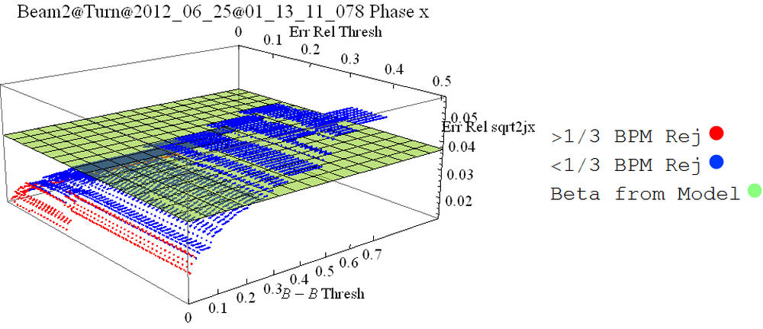
(Err Thresh, B-B Thresh) -> % BPMs Used, $\frac{\frac{σ_{model}}{2J_{model}}−\frac{σ_{phase}}{2J_{phase}}}{\frac{σ_{model}}{2J_{model}}}$
(0.1, 0.15) -> 85.2, 0.37
(0.15,0.15) -> 87.7, 0.25

Slide 11
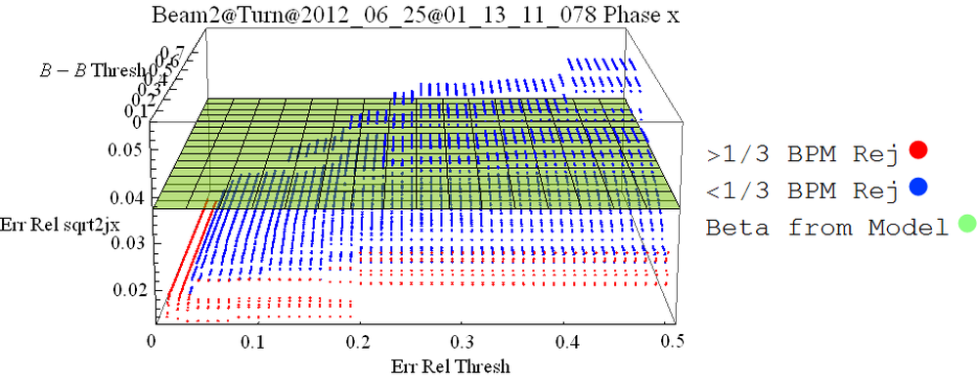
(Err Thresh, B-B Thresh) -> % BPMs Used, $\frac{\frac{σ_{model}}{2J_{model}}−\frac{σ_{phase}}{2J_{phase}}}{\frac{σ_{model}}{2J_{model}}}$
(0.1, 0.15) -> 85.2, 0.37
(0.15,0.15) -> 87.7, 0.25

Slide 12
(Err Thresh, B-B Thresh) -> % BPMs Used, $\frac{\frac{σ_{model}}{2J_{model}}−\frac{σ_{phase}}{2J_{phase}}}{\frac{σ_{model}}{2J_{model}}}$
(0.1, 0.15) -> 85.2, 0.37
(0.15,0.15) -> 87.7, 0.25

Slide 13
(Err Thresh, B-B Thresh) -> % BPMs Used, $\frac{\frac{σ_{model}}{2J_{model}}−\frac{σ_{phase}}{2J_{phase}}}{\frac{σ_{model}}{2J_{model}}}$
(0.1, 0.15) -> 85.2, 0.37
(0.15,0.15) -> 87.7, 0.25

Slide 14
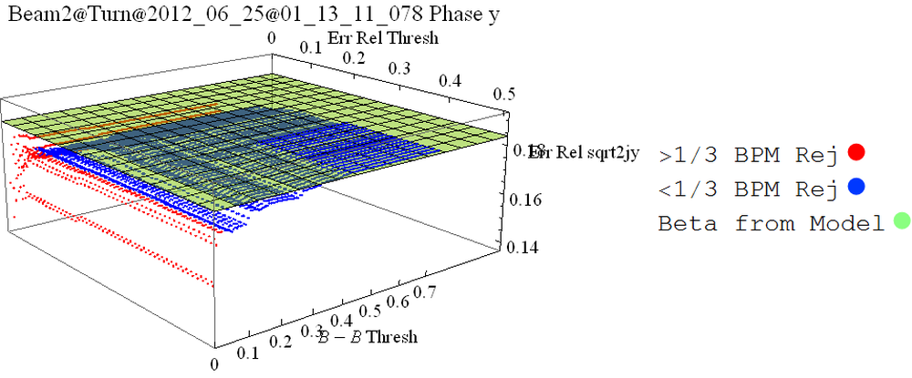
(Err Thresh, B-B Thresh) -> % BPMs Used, $\frac{\frac{σ_{model}}{2J_{model}}−\frac{σ_{phase}}{2J_{phase}}}{\frac{σ_{model}}{2J_{model}}}$
(0.1, 0.15) -> 83.0, 0.041
(0.15,0.15) -> 86.0, 0.030

Slide 15
(Err Thresh, B-B Thresh) -> % BPMs Used, $\frac{\frac{σ_{model}}{2J_{model}}−\frac{σ_{phase}}{2J_{phase}}}{\frac{σ_{model}}{2J_{model}}}$
(0.1, 0.15) -> 83.0, 0.041
(0.15,0.15) -> 86.0, 0.030

Slide 16
(Err Thresh, B-B Thresh) -> % BPMs Used, $\frac{\frac{σ_{model}}{2J_{model}}−\frac{σ_{phase}}{2J_{phase}}}{\frac{σ_{model}}{2J_{model}}}$
(0.1, 0.15) -> 83.0, 0.041
(0.15,0.15) -> 86.0, 0.030

Slide 17
(Err Thresh, B-B Thresh) -> % BPMs Used, $\frac{\frac{σ_{model}}{2J_{model}}−\frac{σ_{phase}}{2J_{phase}}}{\frac{σ_{model}}{2J_{model}}}$
(0.1, 0.15) -> 83.0, 0.041
(0.15,0.15) -> 86.0, 0.030

Slide 18
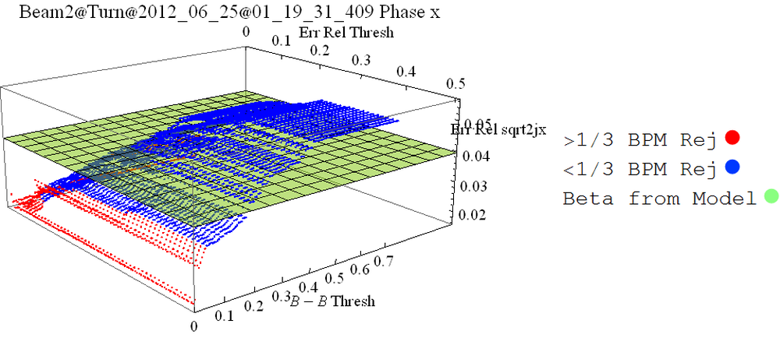
(Err Thresh, B-B Thresh) -> % BPMs Used, $\frac{\frac{σ_{model}}{2J_{model}}−\frac{σ_{phase}}{2J_{phase}}}{\frac{σ_{model}}{2J_{model}}}$
(0.1, 0.15) -> 81.4, 0.25
(0.15,0.15) -> 84.4, 0.18

Slide 19
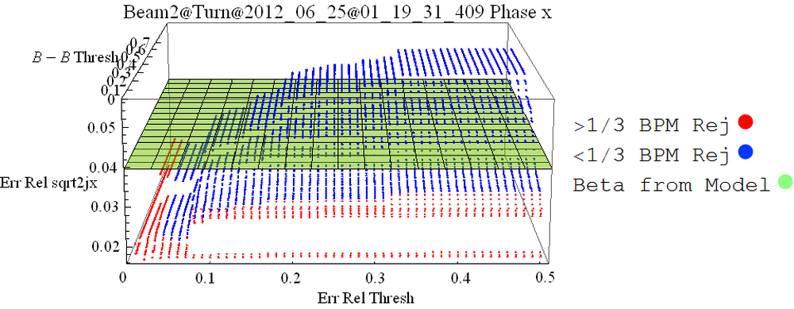
(Err Thresh, B-B Thresh) -> % BPMs Used, $\frac{\frac{σ_{model}}{2J_{model}}−\frac{σ_{phase}}{2J_{phase}}}{\frac{σ_{model}}{2J_{model}}}$
(0.1, 0.15) -> 81.4, 0.25
(0.15,0.15) -> 84.4, 0.18

Slide 20
(Err Thresh, B-B Thresh) -> % BPMs Used, $\frac{\frac{σ_{model}}{2J_{model}}−\frac{σ_{phase}}{2J_{phase}}}{\frac{σ_{model}}{2J_{model}}}$
(0.1, 0.15) -> 81.4, 0.25
(0.15,0.15) -> 84.4, 0.18

Slide 21
(Err Thresh, B-B Thresh) -> % BPMs Used, $\frac{\frac{σ_{model}}{2J_{model}}−\frac{σ_{phase}}{2J_{phase}}}{\frac{σ_{model}}{2J_{model}}}$
(0.1, 0.15) -> 81.4, 0.25
(0.15,0.15) -> 84.4, 0.18

Slide 22
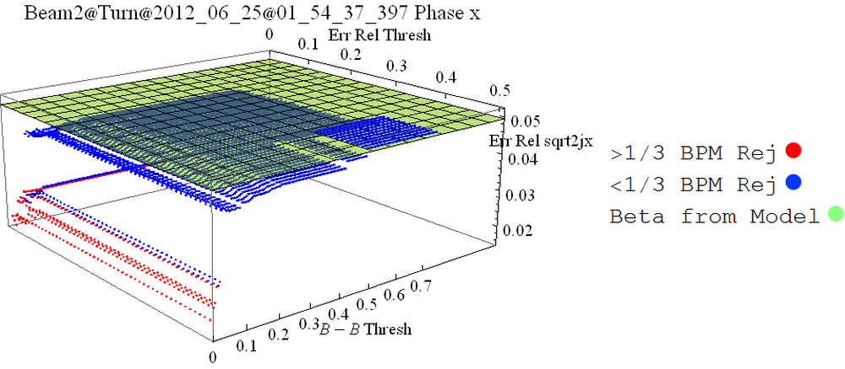
(Err Thresh, B-B Thresh) -> % BPMs Used, $\frac{\frac{σ_{model}}{2J_{model}}−\frac{σ_{phase}}{2J_{phase}}}{\frac{σ_{model}}{2J_{model}}}$
(0.1, 0.15) -> 96.3, 0.091
(0.15,0.15) -> 97.1, 0.094

Slide 23
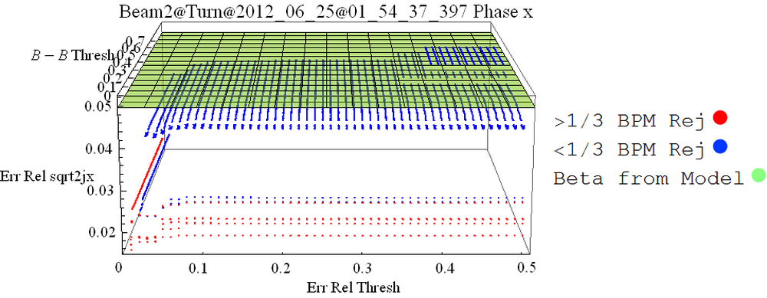
(Err Thresh, B-B Thresh) -> % BPMs Used, $\frac{\frac{σ_{model}}{2J_{model}}−\frac{σ_{phase}}{2J_{phase}}}{\frac{σ_{model}}{2J_{model}}}$
(0.1, 0.15) -> 96.3, 0.091
(0.15,0.15) -> 97.1, 0.094

Slide 24
(Err Thresh, B-B Thresh) -> % BPMs Used, $\frac{\frac{σ_{model}}{2J_{model}}−\frac{σ_{phase}}{2J_{phase}}}{\frac{σ_{model}}{2J_{model}}}$
(0.1, 0.15) -> 96.3, 0.091
(0.15,0.15) -> 97.1, 0.094

Slide 25
(Err Thresh, B-B Thresh) -> % BPMs Used, $\frac{\frac{σ_{model}}{2J_{model}}−\frac{σ_{phase}}{2J_{phase}}}{\frac{σ_{model}}{2J_{model}}}$
(0.1, 0.15) -> 96.3, 0.091
(0.15,0.15) -> 97.1, 0.094

Slide 26
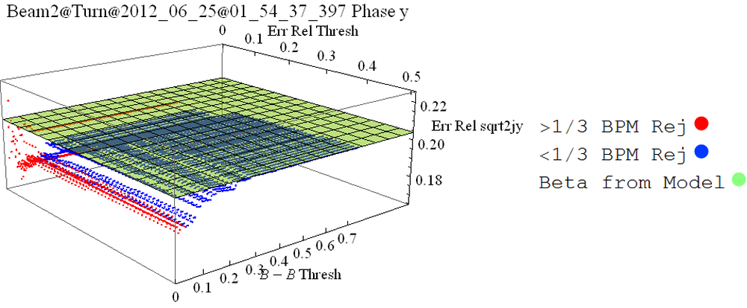
(Err Thresh, B-B Thresh) -> % BPMs Used, $\frac{\frac{σ_{model}}{2J_{model}}−\frac{σ_{phase}}{2J_{phase}}}{\frac{σ_{model}}{2J_{model}}}$
(0.1, 0.15) -> 84.1, 0.051
(0.15,0.15) -> 86.6, 0.048

Slide 27
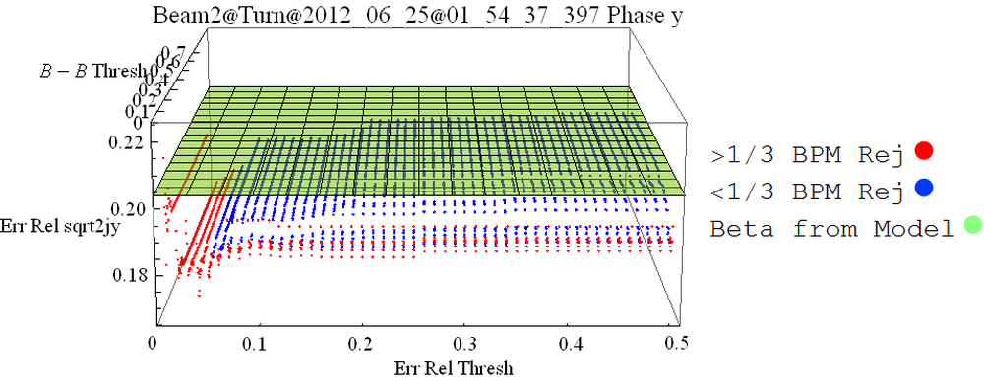
(Err Thresh, B-B Thresh) -> % BPMs Used, $\frac{\frac{σ_{model}}{2J_{model}}−\frac{σ_{phase}}{2J_{phase}}}{\frac{σ_{model}}{2J_{model}}}$
(0.1, 0.15) -> 84.1, 0.051
(0.15,0.15) -> 86.6, 0.048

Slide 28
(Err Thresh, B-B Thresh) -> % BPMs Used, $\frac{\frac{σ_{model}}{2J_{model}}−\frac{σ_{phase}}{2J_{phase}}}{\frac{σ_{model}}{2J_{model}}}$
(0.1, 0.15) -> 84.1, 0.051
(0.15,0.15) -> 86.6, 0.048

Slide 29
(Err Thresh, B-B Thresh) -> % BPMs Used, $\frac{\frac{σ_{model}}{2J_{model}}−\frac{σ_{phase}}{2J_{phase}}}{\frac{σ_{model}}{2J_{model}}}$
(0.1, 0.15) -> 84.1, 0.051
(0.15,0.15) -> 86.6, 0.048

Slide 30
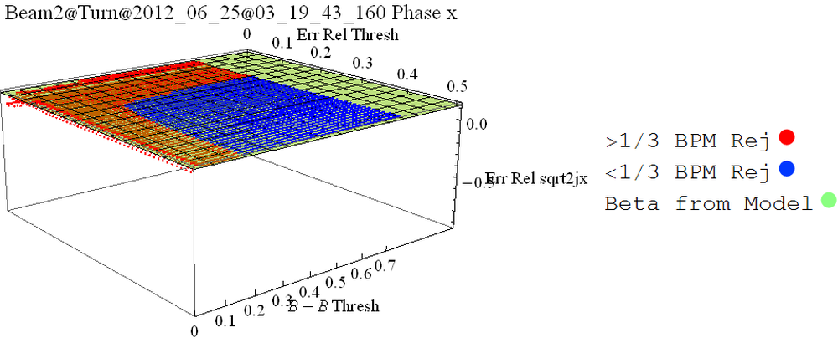
(Err Thresh, B-B Thresh) -> % BPMs Used, $\frac{\frac{σ_{model}}{2J_{model}}−\frac{σ_{phase}}{2J_{phase}}}{\frac{σ_{model}}{2J_{model}}}$
(0.1, 0.15) -> 36.0, 0.044
(0.15,0.15) -> 50.0, 0.060

Slide 31
(Err Thresh, B-B Thresh) -> % BPMs Used, $\frac{\frac{σ_{model}}{2J_{model}}−\frac{σ_{phase}}{2J_{phase}}}{\frac{σ_{model}}{2J_{model}}}$
(0.1, 0.15) -> 36.0, 0.044
(0.15,0.15) -> 50.0, 0.060

Slide 32
(Err Thresh, B-B Thresh) -> % BPMs Used, $\frac{\frac{σ_{model}}{2J_{model}}−\frac{σ_{phase}}{2J_{phase}}}{\frac{σ_{model}}{2J_{model}}}$
(0.1, 0.15) -> 36.0, 0.044
(0.15,0.15) -> 50.0, 0.060

Slide 33
(Err Thresh, B-B Thresh) -> % BPMs Used, $\frac{\frac{σ_{model}}{2J_{model}}−\frac{σ_{phase}}{2J_{phase}}}{\frac{σ_{model}}{2J_{model}}}$
(0.1, 0.15) -> 36.0, 0.044
(0.15,0.15) -> 50.0, 0.060

Slide 34
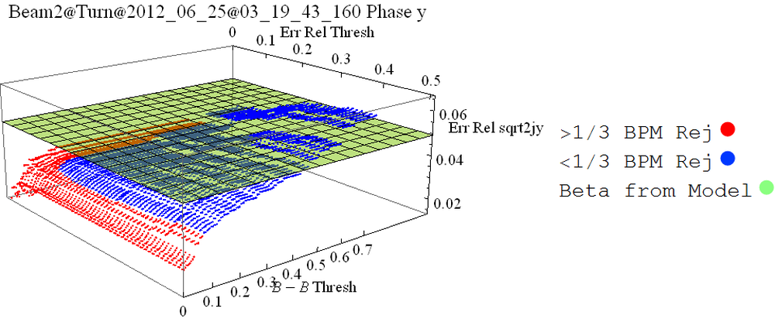
(Err Thresh, B-B Thresh) -> % BPMs Used, $\frac{\frac{σ_{model}}{2J_{model}}−\frac{σ_{phase}}{2J_{phase}}}{\frac{σ_{model}}{2J_{model}}}$
(0.1, 0.15) -> 72.2, 0.33
(0.15,0.15) -> 76.7, 0.31

Slide 35
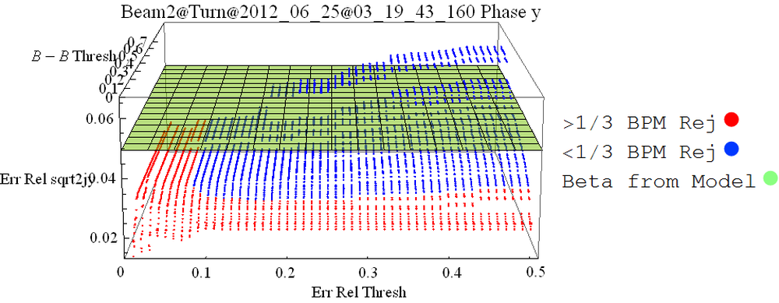
(Err Thresh, B-B Thresh) -> % BPMs Used, $\frac{\frac{σ_{model}}{2J_{model}}−\frac{σ_{phase}}{2J_{phase}}}{\frac{σ_{model}}{2J_{model}}}$
(0.1, 0.15) -> 72.2, 0.33
(0.15,0.15) -> 76.7, 0.31

Slide 36
(Err Thresh, B-B Thresh) -> % BPMs Used, $\frac{\frac{σ_{model}}{2J_{model}}−\frac{σ_{phase}}{2J_{phase}}}{\frac{σ_{model}}{2J_{model}}}$
(0.1, 0.15) -> 72.2, 0.33
(0.15,0.15) -> 76.7, 0.31

Slide 37
(Err Thresh, B-B Thresh) -> % BPMs Used, $\frac{\frac{σ_{model}}{2J_{model}}−\frac{σ_{phase}}{2J_{phase}}}{\frac{σ_{model}}{2J_{model}}}$
(0.1, 0.15) -> 72.2, 0.33
(0.15,0.15) -> 76.7, 0.31

Slide 38
Beta from Amplitude Plots
For only one input file, beta from amplitude always gives $\sqrt{2.2{×10}^{−16}}$ as the uncertainty so threshold for relative uncertainty wasn’t as useful for it- still in place in the code though
Plots that follow show the relative uncertainty on the actions vs. the beta-beating threshold for measurement data

Slide 51
Conclusion
New method of action calculation seems to reduce the uncertainty significantly
The calculation of the dynamic aperture depends directly on the action, so changes should allow for more precision

