Slide 1
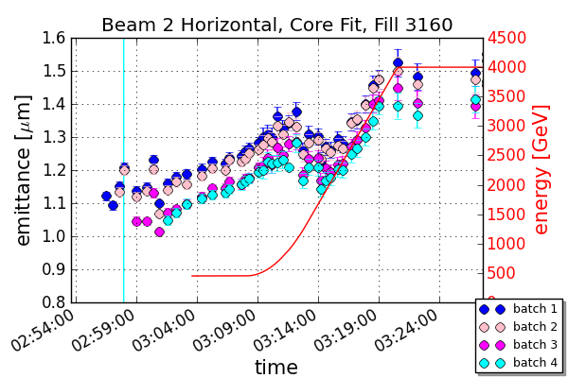
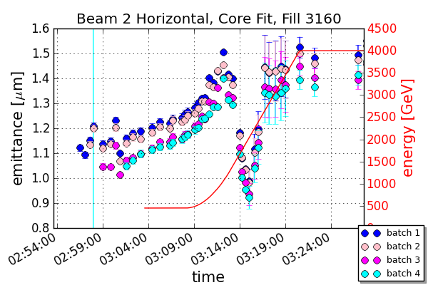
Beta Functions through the Ramp
Updated plots from MD3
Linear interpolation of betas before and after ramp
With betas from Rogelio‘s team during the ramp
Other planes look the same
Shrinkage more emphasized with new betas
Do we trust these values?

Slide 2
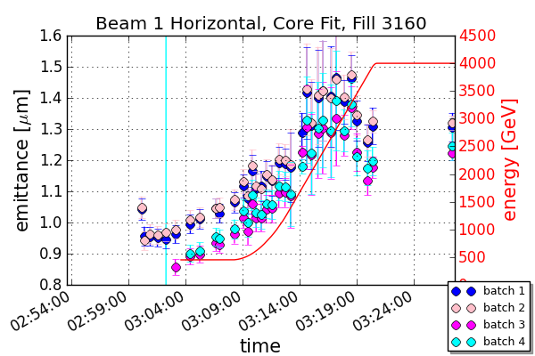
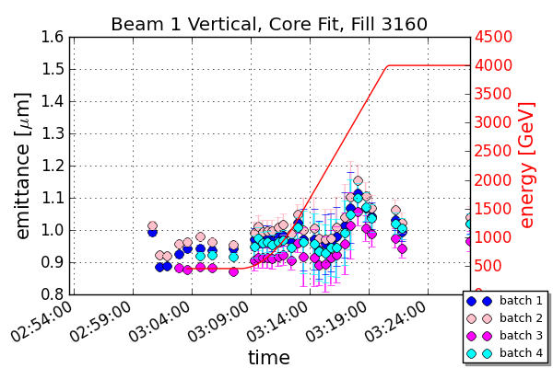
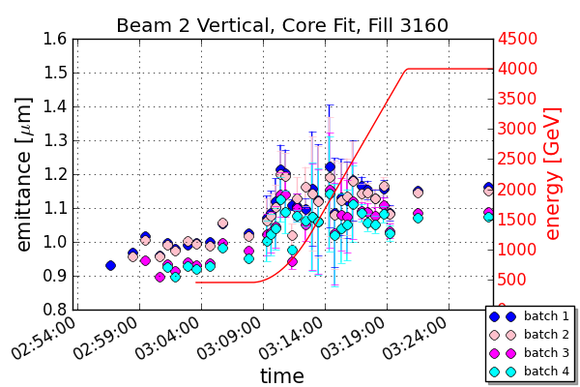
With Ramp Betas All Planes

Slide 3
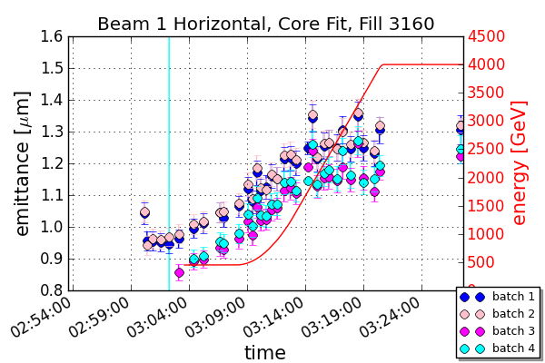
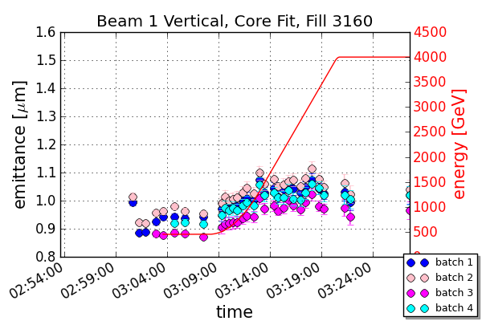
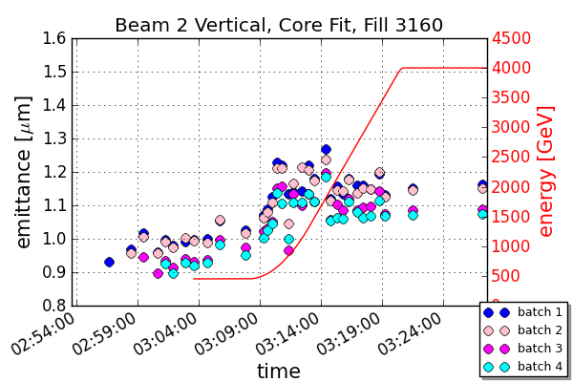
Without Ramp Betas All Planes

